Slide 1

Police Data Challenge
Dave Ho
Santosh Tatipamula
Alexander Vu
Tyler Shockley
Luke Liu
The Bayes

Slide 2
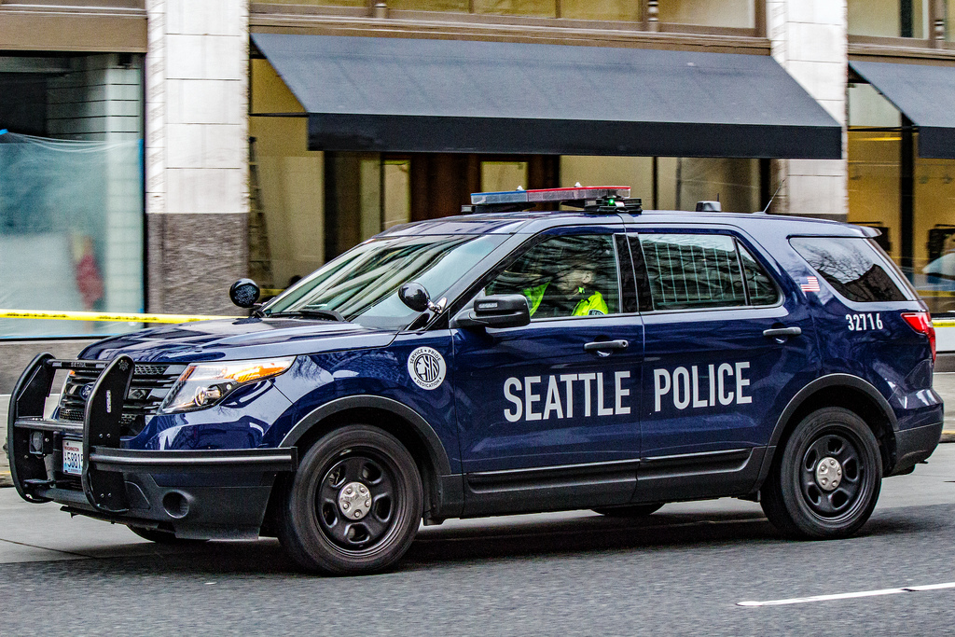
The Objective
As technology continues to grow, data becomes increasingly important
“Information is the resolution of uncertainty” ~ Claude Shannon
Predict future situations
Prioritize limited resources
In this challenge
Study existing seattle police data
Analyze the data
Come up with a possible solution to improve public safety within that area

Slide 3

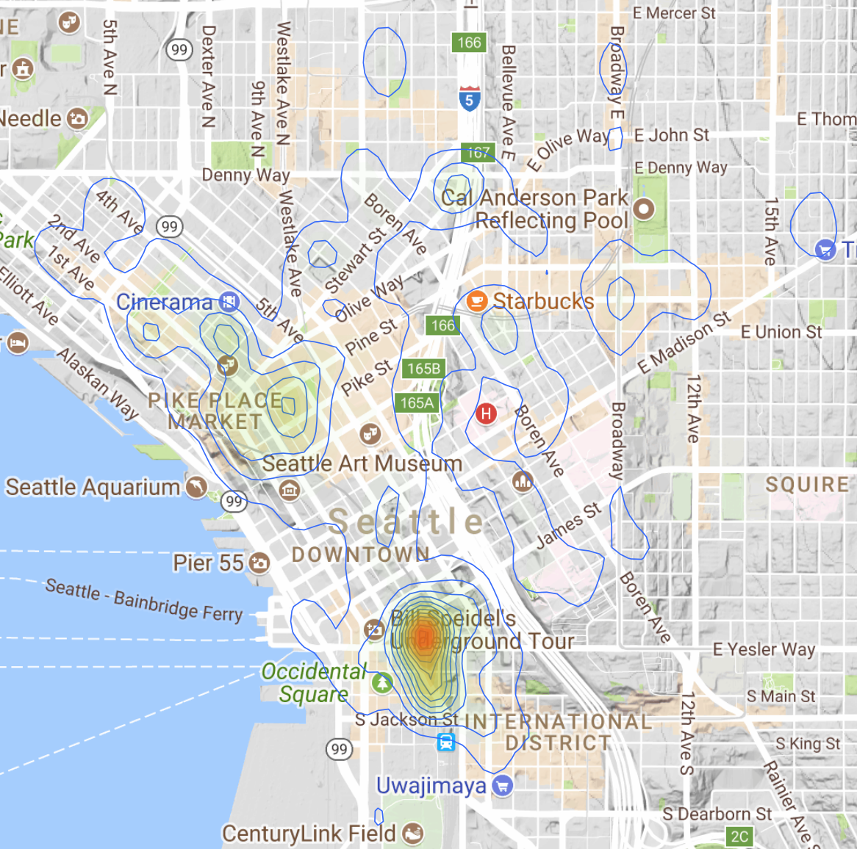
Brainstorming
Initially, we looked at Fire Data
Wanted to observe the density of fires within seattle
Based on that we could have more fire departments in a certain area, hydrants, etc.
Heat maps
However, we wanted relate more to Seattle police
Police 911 incident reports

Slide 4
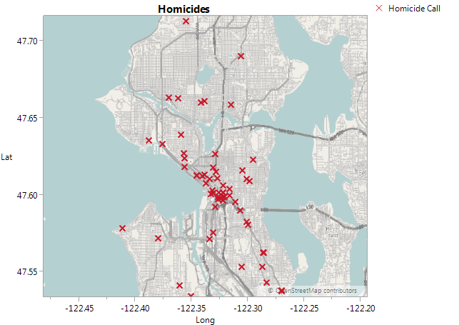
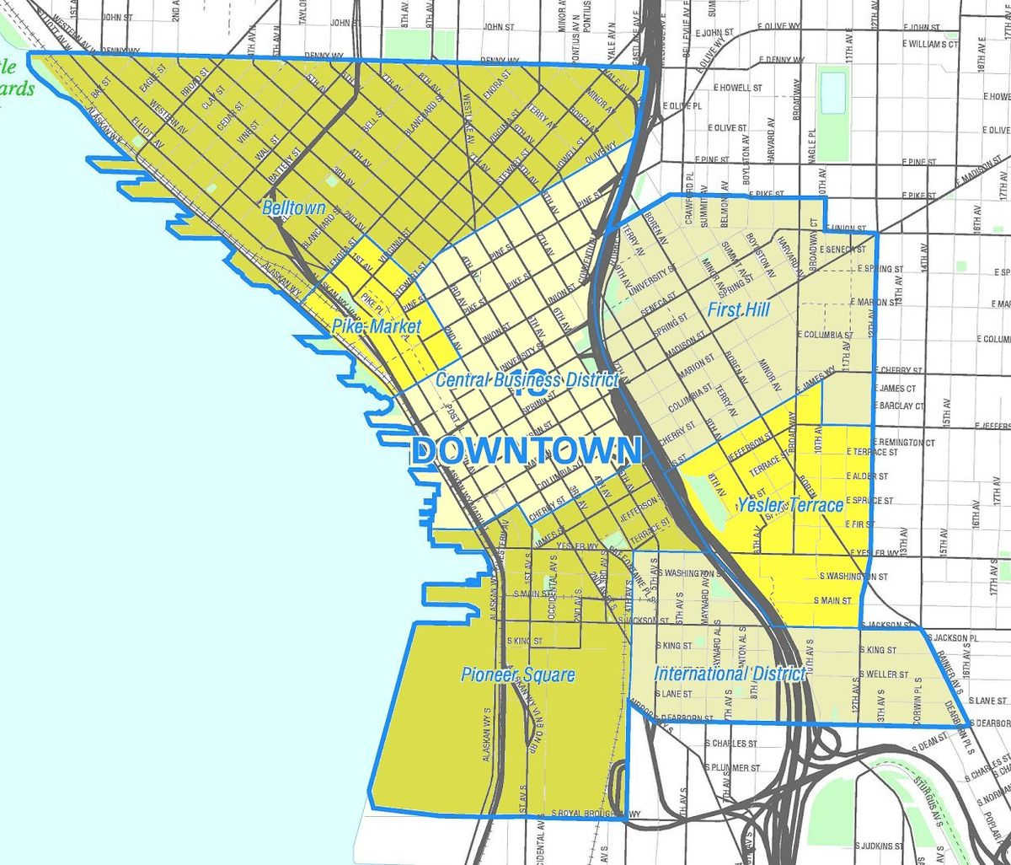
Homicide Heat Map

Slide 5

Cleaning up the Data
We first downloaded the file from data.seattle.gov
Unfortunately, it had 1.5 millions rows spanning 9 years (2009-2017) of data
It also had 10 columns which we did not need
R statistical programming language used to deal with large datasets
R helped us cut down the data set, cutting out 6 years of data (2009-2014) and cutting out columns, in only a few minutes

Slide 6
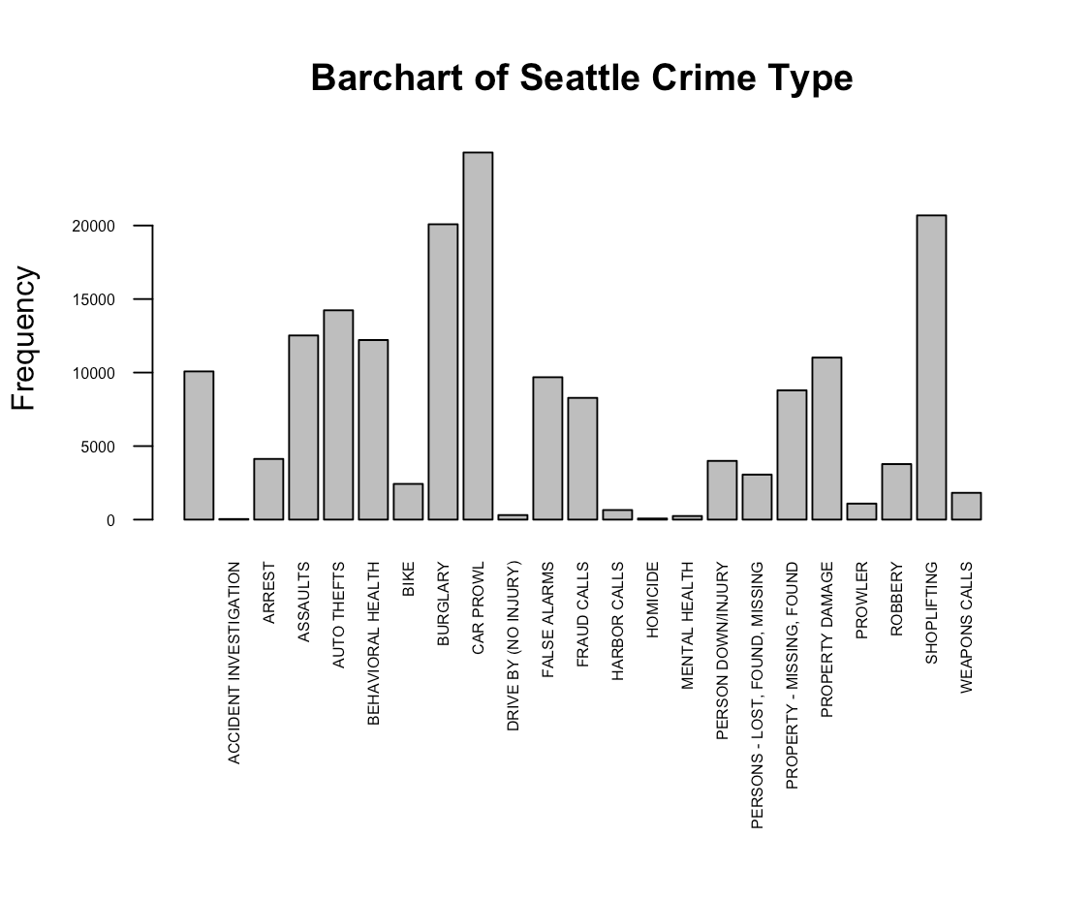
Summary of Crimes
Distribution of Crime Types
X-axis: types of crimes
Y-axis: frequency
Most frequent crimes
1. Car Prowl
2. Shoplifting
3. Burglary

Slide 7
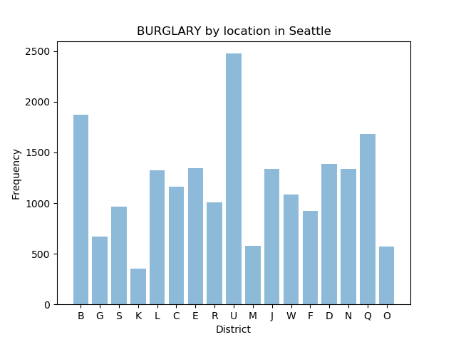
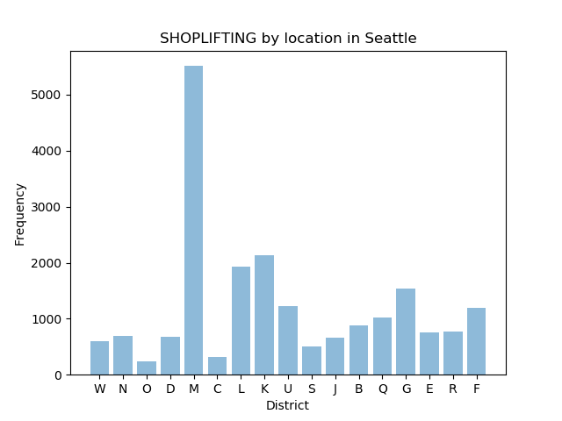
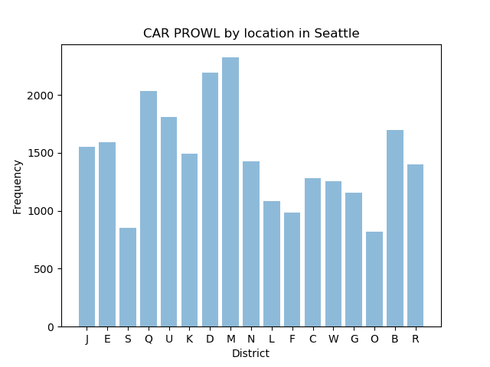
Seattle Crimes by Location

Slide 8
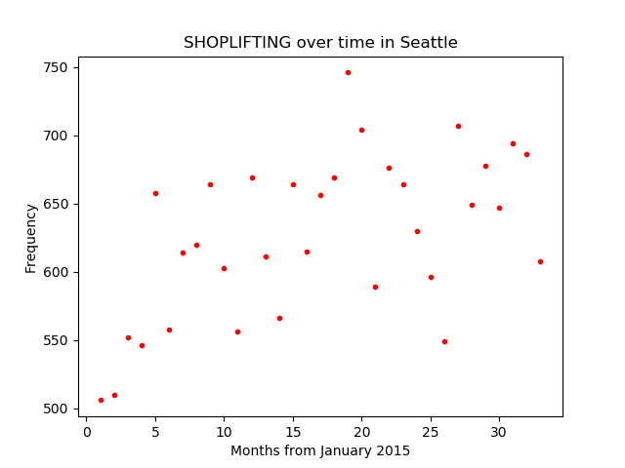
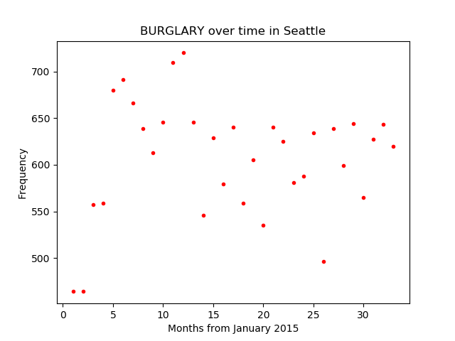
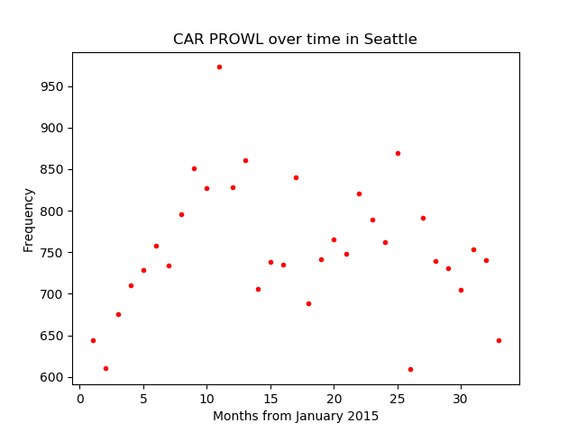
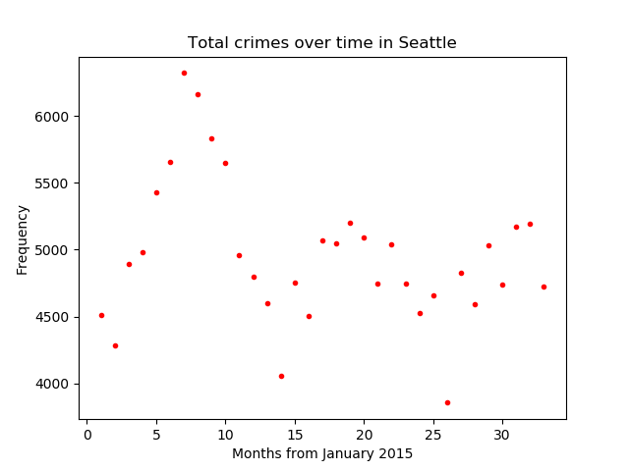
Seattle Crimes over last 3 years

Slide 9
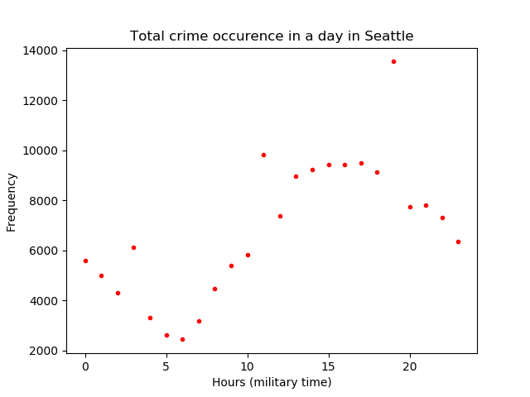
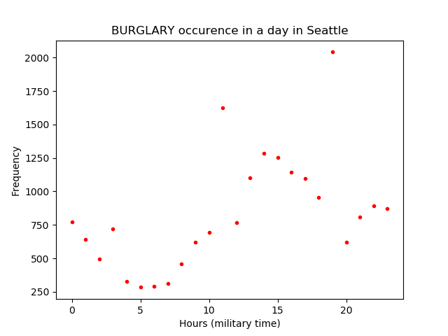
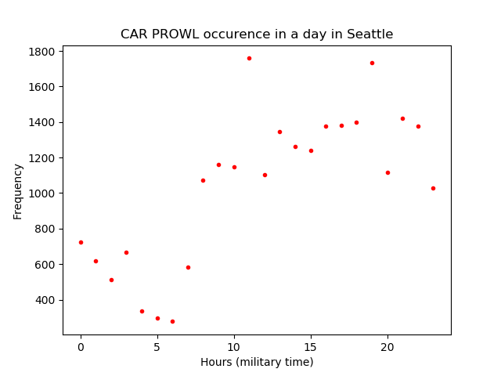
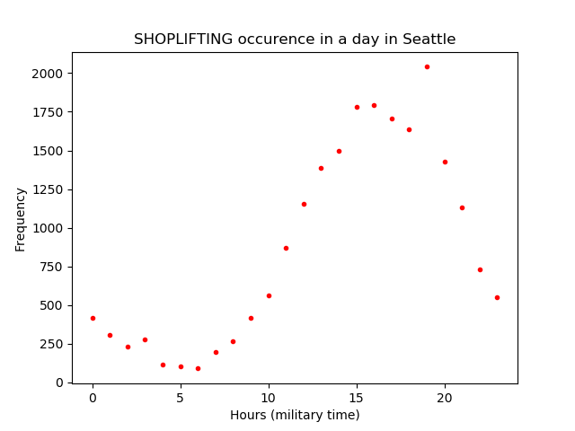
Seattle Crimes in 24-hour period

Slide 10
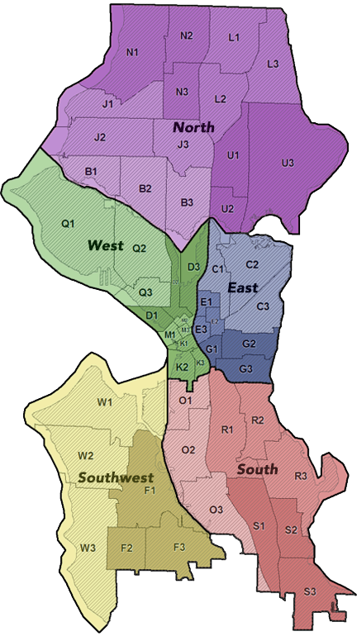
Proposals
Shoplifting dense in the M Zone (Downtown)
M district is also has the highest frequency in homicide rates
Increase security during specific times of day

Slide 11
Sources
https://www.r-project.org/
https://www.jmp.com/en_us/home.html
http://ggplot2.org/
https://matplotlib.org/

